Slide 1


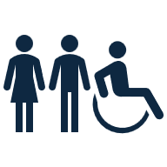

Community stress in DC through 311 calls (2016-2020)
By: Maryam Yusuf. DAB16

Slide 2
Between 2016 and 2020, DC residents made thousands of 311 calls across many departments. The volume and variety of calls made it hard to spot clear patterns. This project analyzes call trends and categorization to identify community stress points.
Problem statement:
highest number calls
monthly change of 311 call volume
change after recategorizing

Slide 3
Which city departments received the highest number of 311 calls between 2016 and 2020?

Slide 4
How did monthly 311 call volume change for the top three departments from 2016 to 2020?

Slide 5
How did that change after recategorizing?

Slide 6
How did that change after recategorizing?

Slide 7
How did monthly 311 call volume change for the top three departments from 2016 to 2020?

Slide 8
Public Works and Transportation consistently receive the most calls.
Monthly trends reveal seasonal stress points.
Breaking down requests reveals more precise patterns.
Next steps:
Predict Priority response time of services and stress points.
Correlation to the number of facilities and services.
Takeaways:

Slide 9
Thank you for listening

